Slide 1

Cinemago
A Modern Movie Recommendation Website

Slide 2
Project Introduction
As a regular movie watcher, I often found myself at a dead end after finishing a film—no immediate follow-up, no tailored recommendation. Every time, I had to search manually for something similar in tone, genre, or style, hoping it would align with my taste.
This led to a bigger idea: Why not build a platform for cinephiles—a space where the community actively contributes ratings and feedback, helping train a recommendation algorithm that understands what kind of movies suit what kind of people?

Slide 3
Advantages & Constraints
Advantages:
Personalised Experience: Users receive suggestions aligned with their unique taste, reducing time spent searching.
Community-Driven Ratings: Human-curated insights enhance the accuracy of recommendations.
Scalability: The system improves as more users contribute data and feedback.
Engagement & Discovery: Helps users explore films they might not have otherwise considered.
Constraints:
Cold Start Problem: New users and new movies lack data, which can affect recommendation accuracy.
Subjectivity of Taste: Personal preferences are hard to model perfectly and may shift over time.
Data Bias: Ratings could be skewed by trends or dominant voices in the community.
Technical Complexity: Building and training an effective recommendation engine requires constant tuning and validation.

Slide 4
Functional & Non-functional Requirements
Functional Requirements:
Users can log in and rate movies.
Movie listings and detailed info are displayed.
Ratings are updated in real-time after submission.
Social media links are clickable and accessible.
Ratings are weighted based on user profiles.
Non-Functional Requirements:
Responsiveness: Ratings update without refreshing the page.
Usability: The Interface is intuitive and clear.
User Experience: Social media links open in new tabs.
Performance: Pages load in under 2 seconds.

Slide 5
Design
Frontend (User Interface):
Built with HTML, CSS
Responsive layout with intuitive rating controls (e.g., stars or sliders)
Clean typography with Anaheim (headings) and Manrope (body)
Backend (Logic & Data Handling):
Developed using C# ASP.NET Core
CSV-based storage system (lightweight and easy to manage)
User authentication system for secure access
Recommendation Engine:
Community-driven rating inputs
Weighted algorithm based on user profiles
Aggregated preferences improve suggestions over time

Slide 6
Architecture
Event Driven Architecture: Presentation Layer
Application Layer

Slide 7
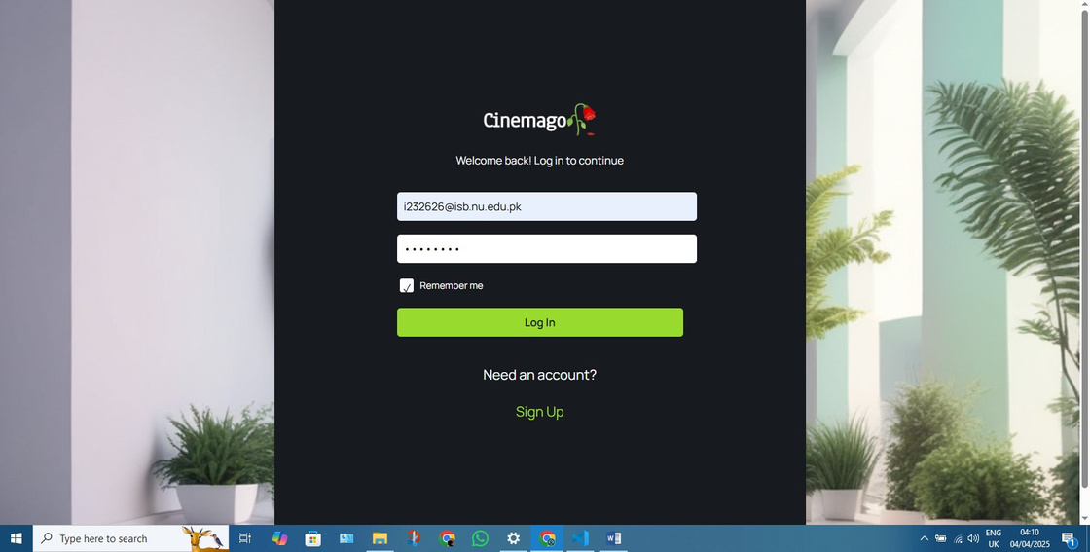
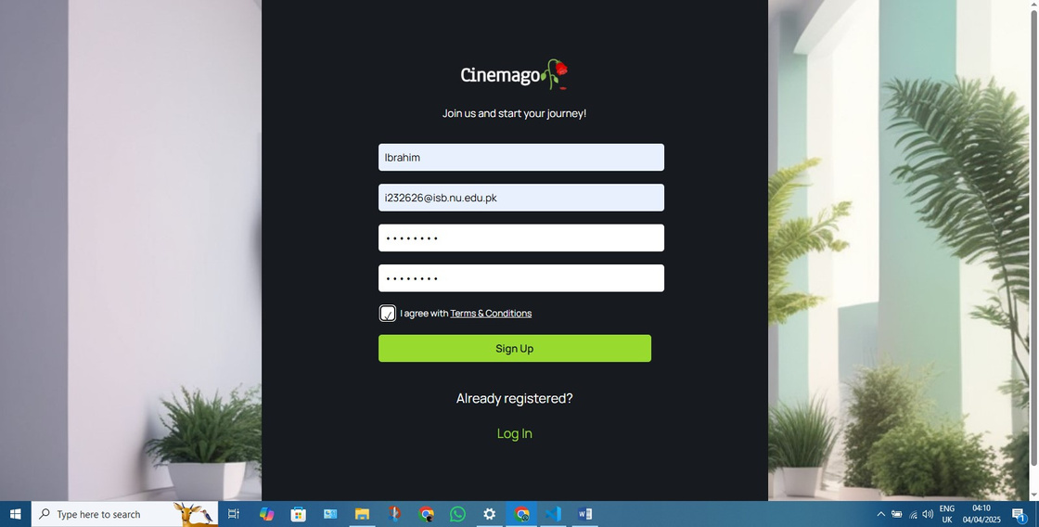
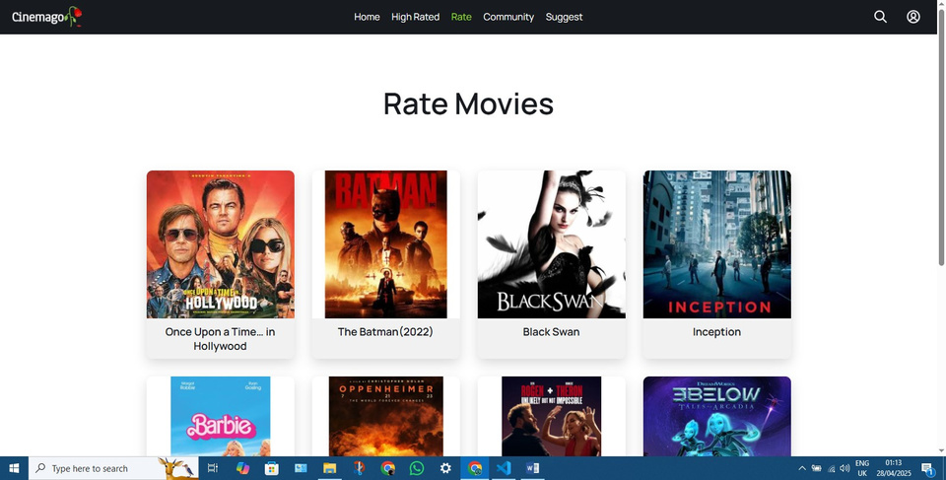
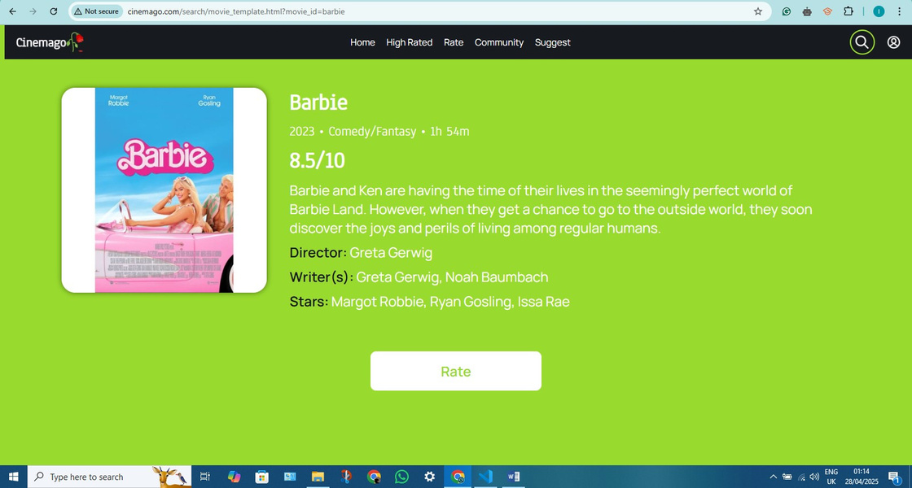
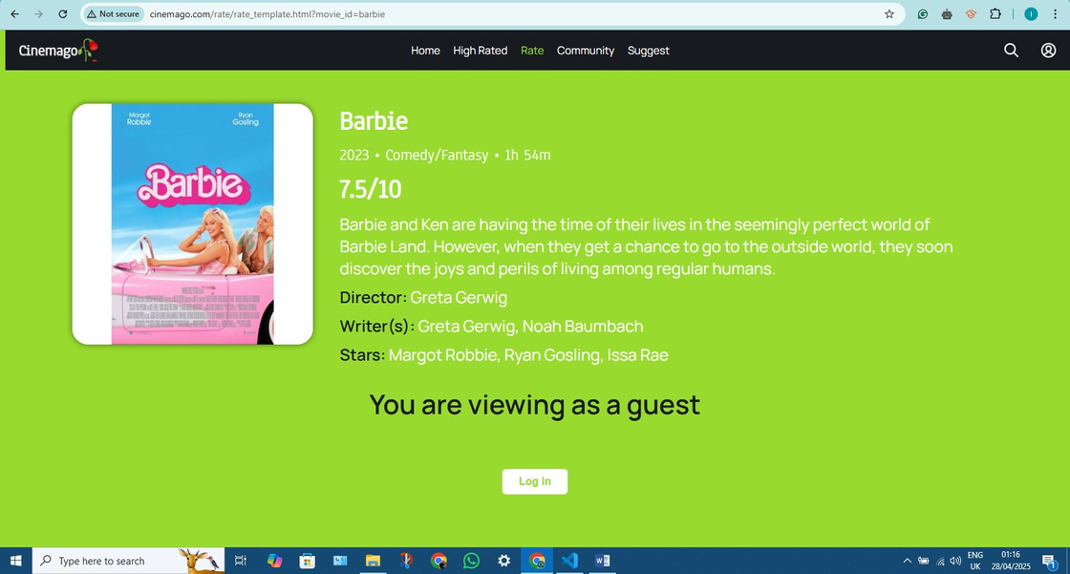
Implementation

Slide 8
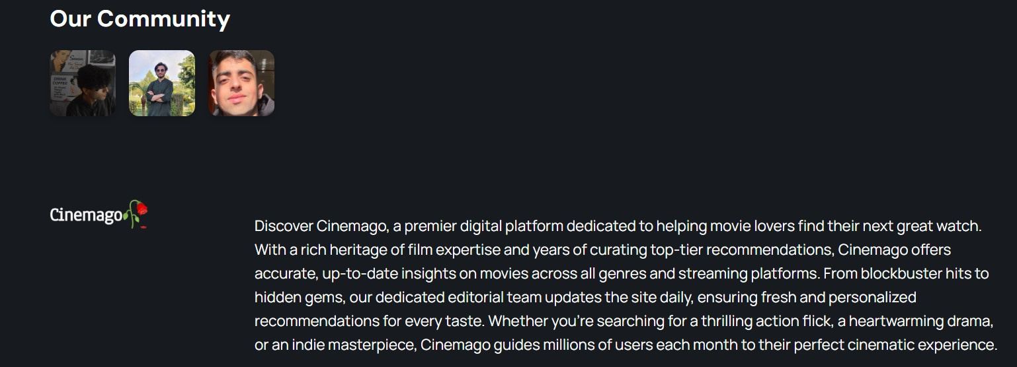



Work Division
Ibrahim:
Contributed towards making the site, proposing the idea and implementing it into what it looks like now.
Wajahat:
Took the task of making documentation for the project.
Saad:
Put forward all User Stories, did the requirement engineering, and made all the diagrams throughout the project.

Slide 9
Lessons Learnt
Web development is significantly more challenging than conventional programming — it requires integration of design, logic, and user experience.
Working with C# and ASP.NET presented unexpected complexity, highlighting both the power and rigidity of the language.
Collaborative group work demands effective communication, coordination, and compromise — far from easy.
Even implementing a simple recommendation algorithm revealed the need for a large and well-structured dataset.
UI/UX design is a fascinating but demanding field — balancing aesthetics, functionality, and usability is no small task.

Slide 10
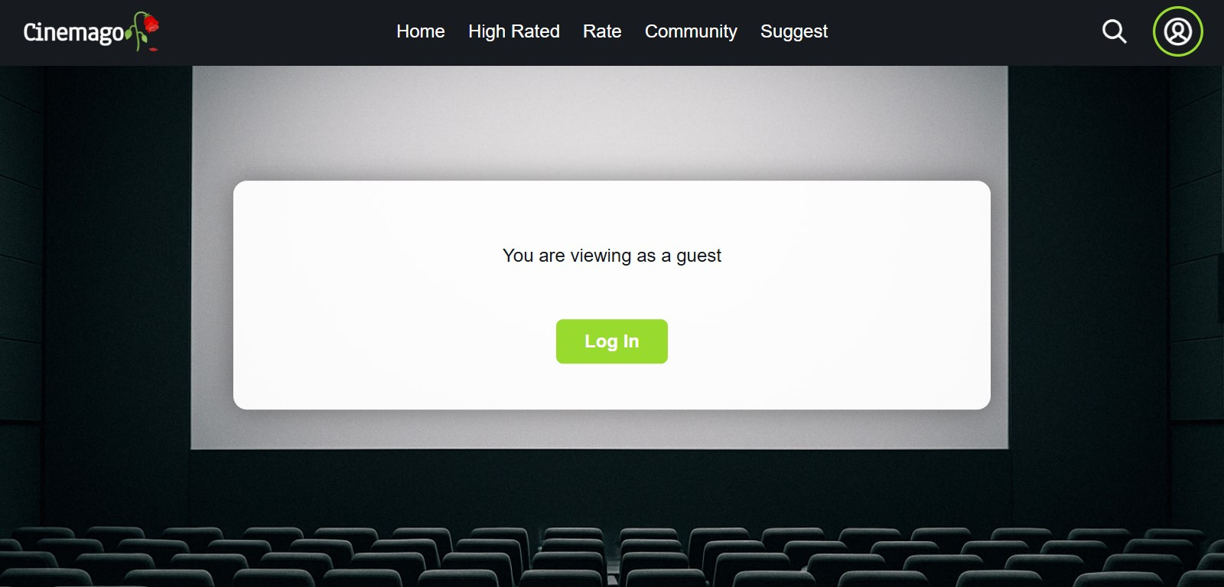
Thank You!
Come on and join us

